Slide 1
CLC1151 Lesson 2: Nihao 你好
Chinese Language Centre
PolyU
Sarah Wong

Slide 2

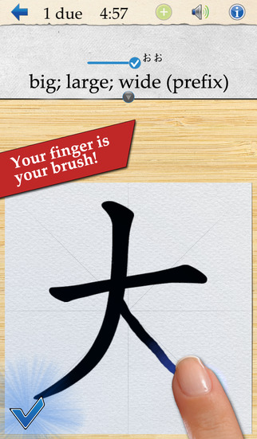
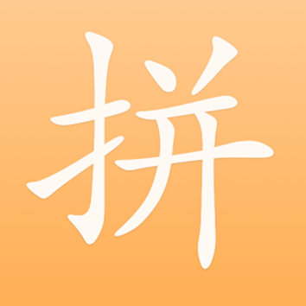
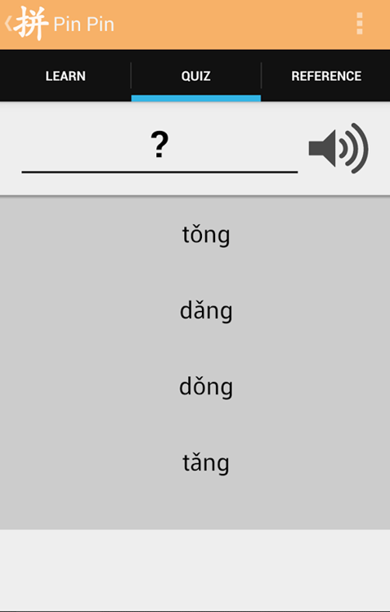
Before the lesson
Skritter
Pin Pin

Slide 3
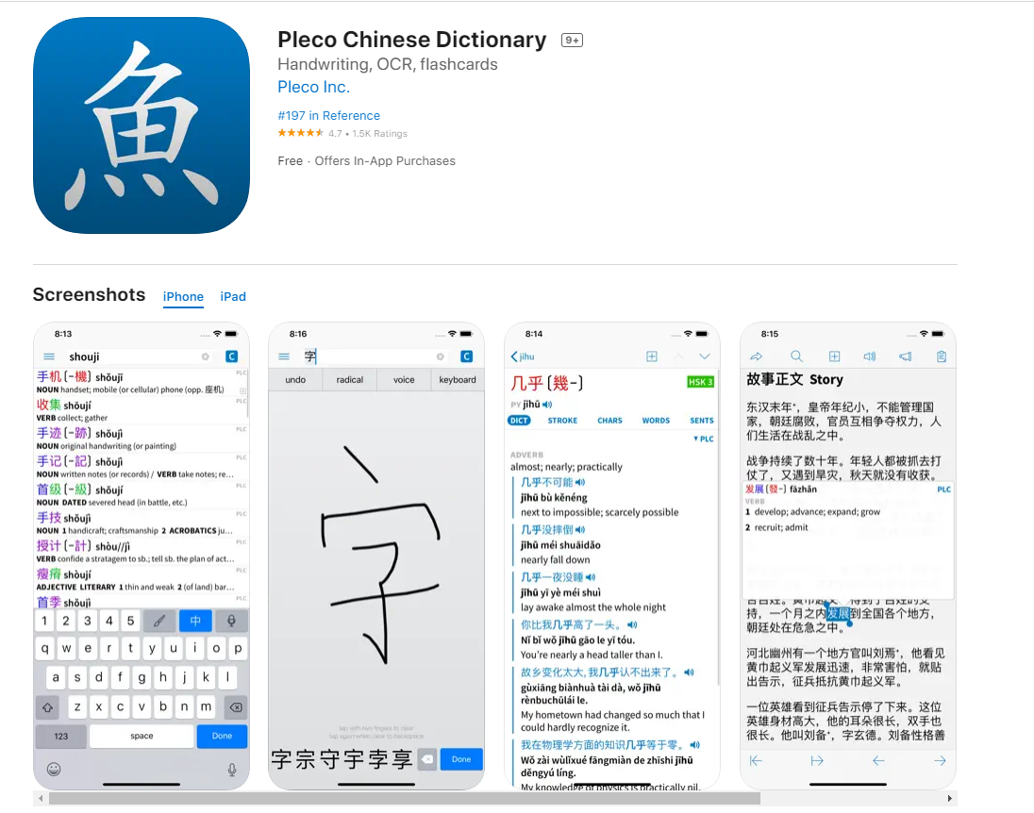

Slide 4


How can I check the right pronunciation?
Putonghua (Mandarin)
Cantonese
http://www.zdic.net/
http://humanum.arts.cuhk.edu.hk/Lexis/lexi-can/
Google Translate?

Slide 5
Putonghua
Putonghua = Mandarin
普通话
普通話
Difference?

Slide 6
Chinese Language Background Info
1, Simplified (Mainland China, Singapore, etc…)
2, Traditional (Hong Kong, Taiwan)
长 VS長
车 VS 車
广VS廣

Slide 7
This Course
Both simplified and traditional Chinese
Putonghua (Mandarin)

Slide 8
Hong Kong’s language background
Cantonese
Putonghua
English

Slide 9
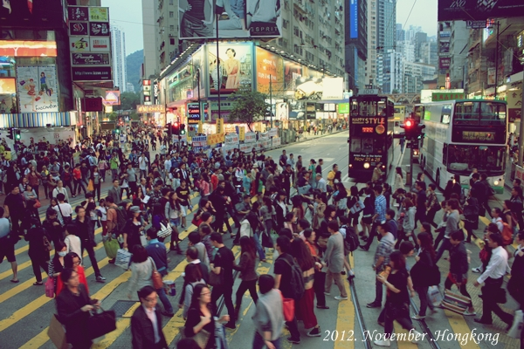

香港
Hoeng1 Gong2
Xiāng Gǎng
Hong Kong

Slide 10
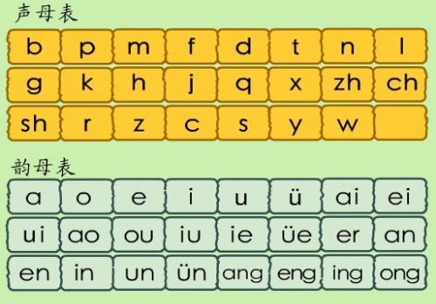
Pinyin: Initials and Finals
ia, ian, uai, ua, uo, uan,iong

Slide 11
Videos of Pinyin pronunciations
Learn Chinese Alphabet
Initials: from 01:55
Finals: from 02:55
z c s zh ch sh r

Slide 12
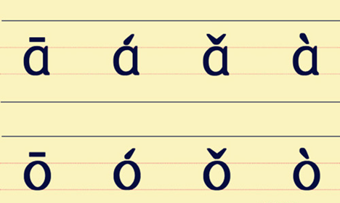
Four Tones

Slide 13
Today’s Initials and Finals
Initials:
b
p
m
n
l
h
Finals
a o e i u ü
ao en ie in ing uo
Read the text on page 3

Slide 14
Text book
Page 3: role play
“lì bō ,nǐ hǎo .”
Can we say “nǐ hǎo, lì bō ”?
“nǐ hǎo, lù yǔ píng”
Can we say “lù yǔ píng, nǐ hǎo”?

Slide 15
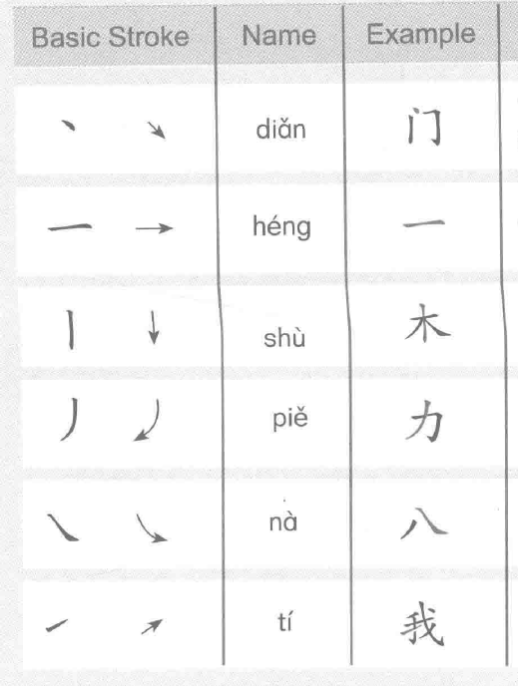
Basic Chinese Character Strokes

Slide 16
zài jiàn 再见

